Slide 1
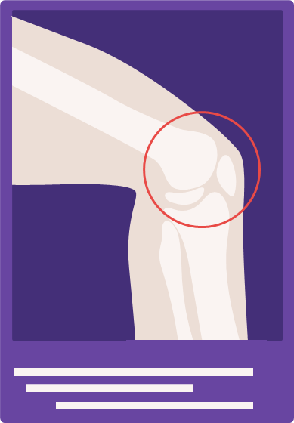
نحوه مدیریت سلامت استخوان ها در خانم 58 ساله مبتلا به دیابت در درمانگاه پزشکی خانواده
ارائه ‌دهنده: امیرسامان نوشک (اینترن پزشکی خانواده)
استاد راهنما: خانم دکتر منصوری
تاریخ ارائه: 1404/12/9

Slide 2
Chief Complaint
مراجعه جهت ارزیابی سلامت دوره ای

Slide 3
Present illness
بیمار خانم 58 ساله مبتلا به دیابت از 10 سال قبل که جهت ارزیابی دوره ای سلامت خود به مرکز جامع خدمات سلامت مراجعه کرده است. شکایت خاصی را مطرح نمی کند.

Slide 4
Past Medical History
دیابت نوع 2؛ از 10 سال قبل
فشارخون بالا؛ از 5 سال قبل

Slide 5
Drug History
Insulin Glargine; 20 u
Insulin Aspart; 8 u - TDS
Metformin 500 mg - TDS
Empagliflozin 10 mg - Daily
Valzomix 160/5 - Daily
Atorvastatin 40 mg -Daily

Slide 6
Family History
پدر؛ فشارخون بالا
برادر؛ دیابت

Slide 7
Allergic & Social History
مورد خاصی را ذکر نمی کند.

Slide 8
Physical Examination
بیمار خانم 58 ساله مورد قبلی دیابت ویزیت شد. هوشیار و اورینته است. Ill و toxic نیست. pale و icteric نیست.
Vital Signs: HR=92 RR=14 BP=130/85 T=36.3
Weight: 67 kg Height: 160 cm BMI: 26.17
سمع قلب نرمال است و سوفل سمع نشد.
سمع ریه نرمال است.
شکم نرم و بدون تندرنس است.
در معاینه عصبی شواهدی از نوروپاتی دیابتی ندارد.

Slide 9
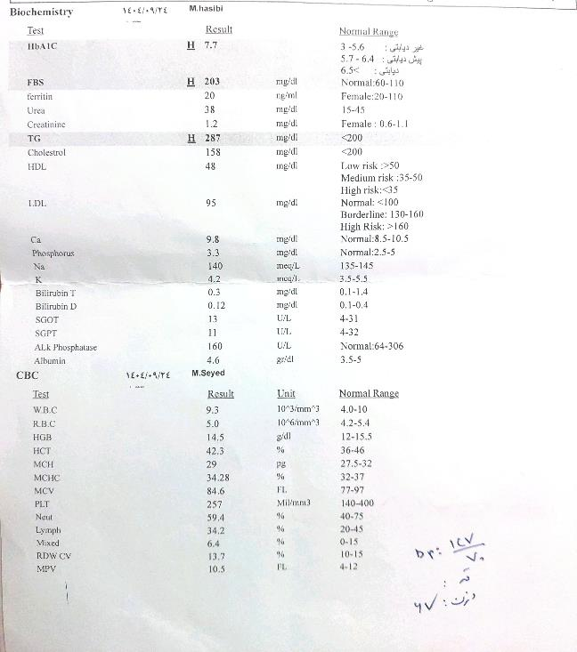

Slide 10
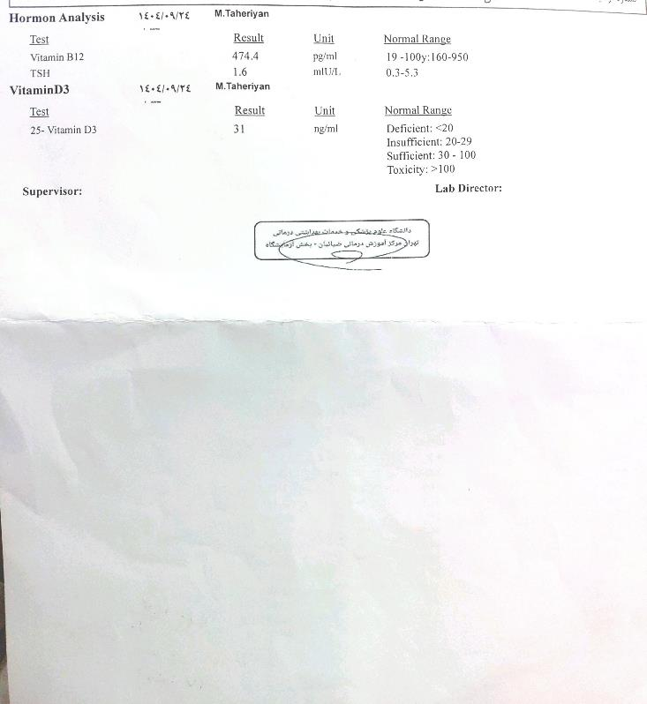

Slide 11
ارزیابی سلامت استخوان در مبتلایان به دیابت بر اساس دستورالعمل ADA 2026

Slide 12
Osteoprosis
WHO: T-Score ≤ - 2.5 SD
Low-trauma fractures in hip, pelvis, vertebra or forearm in 65 y/o and older

Slide 13
Importance of Bone Health in Diabetics
34% increase in fracture risk compared with those w/o DM
Higher mortality rate in the first after fracture
Longer recovery and delayed healing process
Low-trauma fractures

Slide 14
DM type 1
Hip fractures: 4.35x increased risk
Upper limb: 1.83x, Ankle: 1.97x
Fractures occur 10–15 years earlier than general population
Risk factors:
A1C >7.9% (RR 3.57)
Duration >26 years (RR 7.6)
Family history of fractures (RR 2.64)
Microvascular complications, neuropathy

Slide 15
DM type 2; The BMD Paradox
The Paradox: Normal-to-high BMD but accelerated bone loss
Hip fracture risk: 1.79x increased
Lifetime risk: 40–70% higher
Vertebral fractures: 35% higher incidence
Mortality after vertebral fracture: HR 2.11

Slide 16
Glycemic Control and Fracture Risk
Per 1% A1C increase: 8% higher fracture risk (RR 1.08)
A1C >9% over 2 years: 29% increased risk
Hypoglycemia: RR 1.52 for fractures
Severe hypoglycemia: HR 2.24 in Japanese study
Duration matters: >10 years T2D = significantly higher risk

Slide 17
Pathophysiology
Advanced glycation end products (AGEs) in bone matrix
Microvascular damage
Proinflammatory state
Impaired bone cell activity
Poor microdamage repair
Contributing factors: CVD, nephropathy, neuropathy, falls, sarcopenia

Slide 18
Screening Challenges in Type 2 Diabetes
T2D patients have 5–10% higher BMD but weaker bone
Fracture risk higher for any given T-score
Proposed T-score adjustment: −0.5
Example: T-score ≤−2.0 in diabetes = −2.5 in non-diabetes

Slide 19
The FRAX Problem in Diabetes
a computer-based algorithm that calculates the 10-year probability of a major osteoporotic fracture and a hip fracture
FRAX does NOT include diabetes as a risk factor
Result: Systematic underestimation of fracture risk
Proposed solutions:
Input "rheumatoid arthritis" as surrogate for diabetes
Lower femoral neck T-score by 0.5 SD
Increase age by 10 years
Incorporate trabecular bone score adjustments

Slide 20
Screening Recommendations; DM type 2
All adults ≥65 years
Adults ≥50 years with:
Insulin use
Diabetes duration >10 years
Other bone/diabetes risk factors
Repeat DXA every 2–3 years
Metabolic surgery: DXA every 2 years

Slide 21
Screening Recommendations; DM type 1
Hip fracture risk increases after age 50
Consider BMD assessment:
After 5th decade
Earlier if low-trauma fracture or risk factors present
Routine DXA in children/adolescents not recommended (consider if celiac disease)

Slide 22
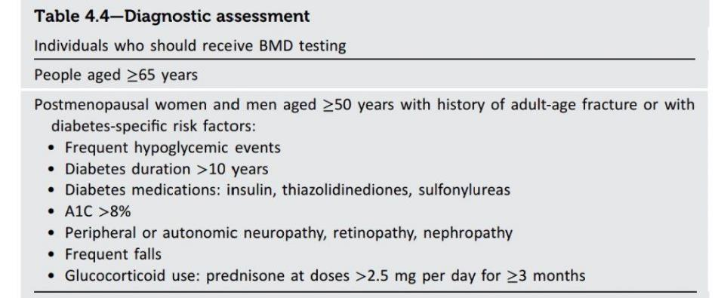

Slide 23
Foundational Management
Glycemic control: Minimize hypoglycemia
Physical activity: Aerobic + weight-bearing + balance/flexibility
Lifestyle: Smoking cessation
Nutrition:
Protein adequacy
Calcium: 1,000–1,200 mg/day (age-based)
Vitamin D: 600–800 IU/day (51-70 y/o: 600 IU/day, more than 70: 800 IU/day) - >30 ng/mL is recommended

Slide 24
When to Start Pharmacologic Treatment?
General population criteria:
T-score ≤−2.5
OR FRAX: Hip ≥3% or Major osteoporotic ≥20%
For Type 2 Diabetes (adjusted):
Strongly consider treatment if: T-score −2.0 to −2.5 PLUS additional risk factors (falls, elevated FRAX)
Based on T-score underestimation principle

Slide 25
When to Start Pharmacologic Treatment?
Mechanism | Examples | Class
↓ Bone resorption | Bisphosphonates, SERMs, Denosumab | Antiresorptives
↑ Bone formation | Teriparatide, Abaloparatide | Osteoanabolics
↑ Formation + ↓ Resorption | Romosozumab | Dual-action

Slide 26
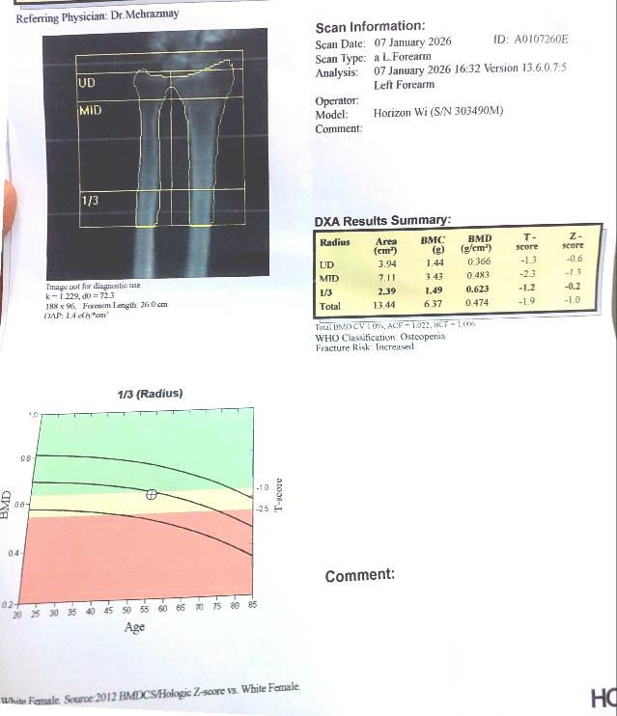

Slide 27
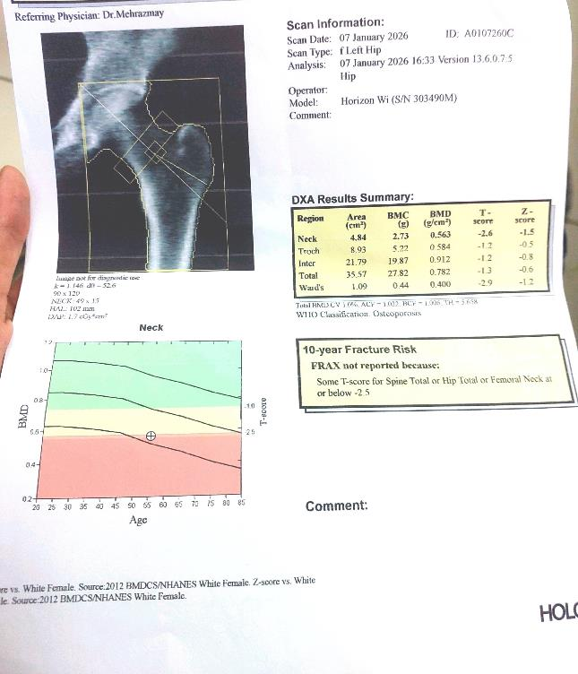

Slide 28
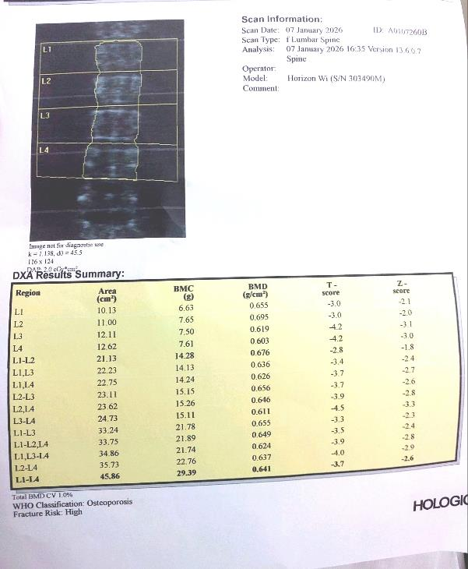

Slide 29
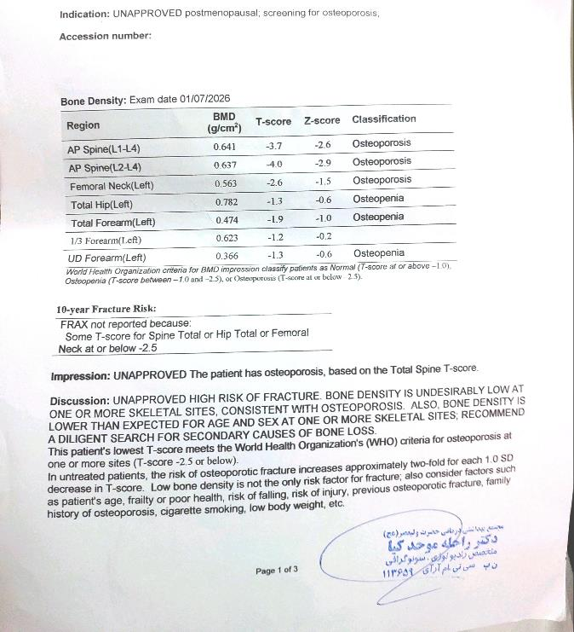

Slide 30
Glucose-Lowering Medications: Bone Safety Profile
Metformin: Safe – Neutral
TZDs: Increased risk - risk decreases after discontinuation
Sulfonylureas: Increased risk - hypoglycemia + bone loss
DPP-4 Inhibitors: Neutral - 15+ years of safety data
GLP-1 Ras: Likely neutral/beneficial
SGLT2 Inhibitors: (Canagliflozin concern) - others neutral
Insulin: Hip fracture risk doubled - Hypoglycemia, duration, comorbidities

Slide 31
Prevention: After Fragility Fracture
Diagnosis: low-trauma fracture is considered osteoporosis regardless of BMD
Immediate action:
Start anti-osteoporosis therapy ASAP
Calcium/vitamin D as needed
Can initiate during inpatient stay

Slide 32
Prevention Level | Goal | Target Population | Key Interventions
Primordial | Prevent development of diabetes and bone risk factors | General population, children, adolescents | Public health campaigns, school-based nutrition/exercise, maternal-child health, maximize peak bone mass
Primary | Prevent first fracture in at-risk individuals | All people with diabetes (no prior fracture) | Glycemic control (A1C target), hypoglycemia prevention, fall risk assessment, bone-safe medications, calcium/vitamin D, weight-bearing exercise, smoking cessation
Secondary | Early detection and treatment | Diabetes + low BMD (T-score -2.0 to -2.5) or high FRAX | DXA screening (T2D: ≥65yr or ≥50yr with risk factors; T1D: after 50), T-score adjustment (-0.5), FRAX adjustment, initiate pharmacotherapy
Tertiary | Reduce complications after fracture | Diabetes + established fragility fracture | Osteoporosis diagnosis regardless of BMD, immediate anti-osteoporosis therapy, fracture liaison services, rehabilitation, fall prevention, specialist referral
Quaternary | Avoid unnecessary/over-treatment | Over-treated individuals, low-risk patients | Avoid routine vitamin D/calcium for primary prevention in older adults (USPSTF), de-prescribing, appropriate treatment duration, avoid denosumab in non-adherent patients

